Slide 1
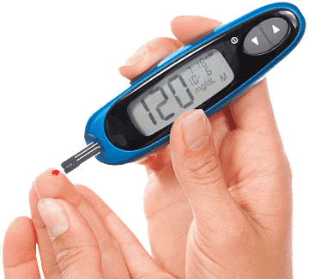
DIABETES MELLITUS PREDICTION USING IBM AUTO AI & SERVICES.
TEAM MEMBERS :
SRIMAN SAI CHARAN
SAMEER SHAIKH VENU MADHAV YAMINI GOUD
01

Slide 2
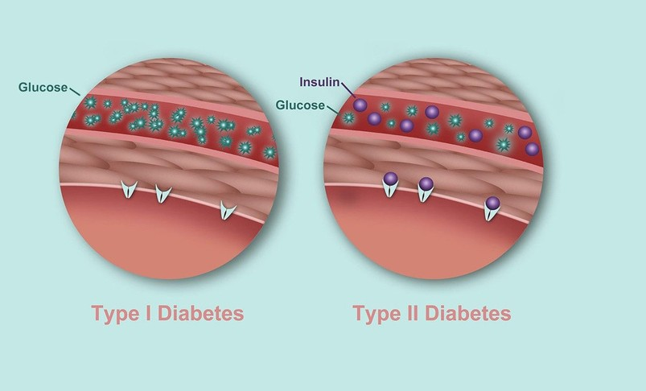
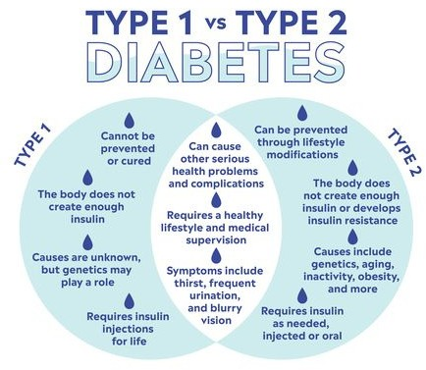
What is Diabetes Mellitus?
Diabetes mellitus is a disorder in which the body does not produce enough or respond normally to insulin, causing blood sugar (glucose) levels to be abnormally high.
Type 1 diabetes
What Is Type 1 Diabetes?
Type 1 diabetes is a condition in which your immune system destroys insulin-making cells in your pancreas. These are called beta cells. The condition is usually diagnosed in children and young people, so it used to be called juvenile diabetes.
Type 2 diabetes
Type 2 diabetes is a lifelong disease that keeps your body from using insulin the way it should. People with type 2 diabetes are said to have insulin resistance.
People who are middle-aged or older are most likely to get this kind of diabetes. It used to be called adult-onset diabetes.
02

Slide 3
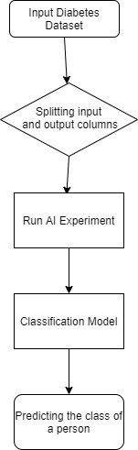
Flow of the Project
There are 5 major steps in creating our project :
Diabetes Dataset
Splitting the dataset into train and test sets
Run an Auto AI Experiment
Classification Model
Predict the class of the person
03

Slide 4
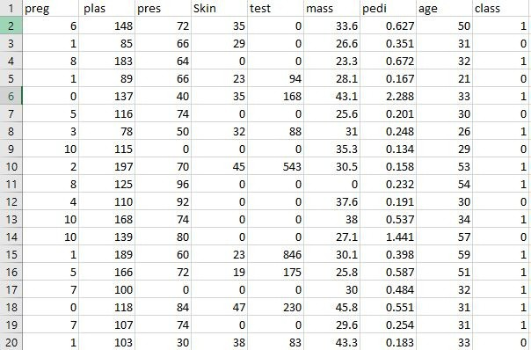
Dataset
Pima-India-Diabetes Data
The attributes of dataset are :
Pregnancies : Number of times pregnant
Glucose: Plasma glucose concentration over 2 hours in an oral glucose tolerance test
BloodPressure: Diastolic blood pressure (mm Hg) SkinThickness: Triceps skin fold thickness (mm) Insulin: 2-Hour serum insulin (mu U/ml)
BMI: Body mass index (weight in kg/(height in m)2)
Diabetes Pedigree Function: a function which scores likelihood of diabetes based on family history
769 Rows and 9 Columns
Age: Age (years) and Outcome: Class variable (0 if non-diabetic, 1 if diabetic)
04

Slide 5
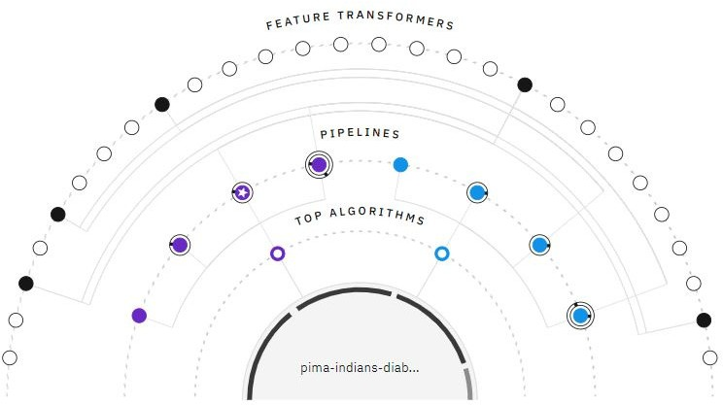
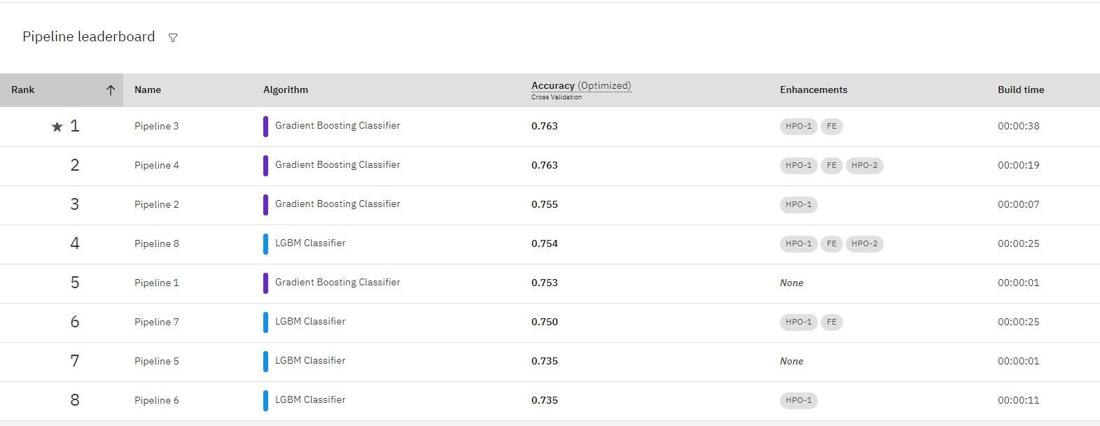
Algorithm & Accuracy
Gradient Boosting Classifier is used. It's a built in classification algorithm in IBM
Auto AI with 0.763 accuracy and deployed on Watson Studio using Machine Learning Service.
05

Slide 6
Node-Red Flow
The web application of the project is built using Node- Red. The below photo is the flow of the Node-Red App
06

Slide 7
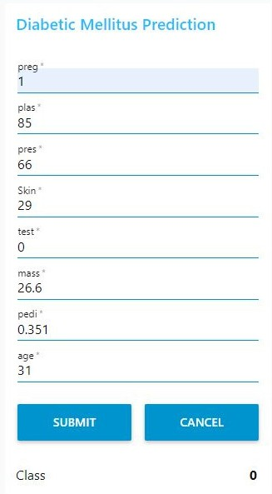
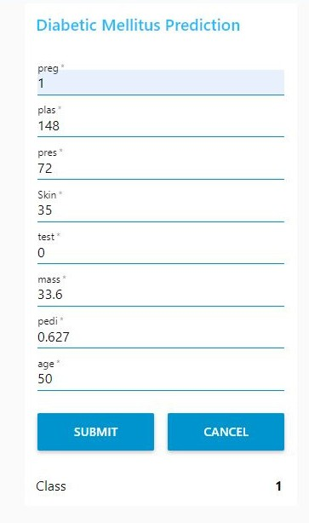
Output
07

Slide 8

THANKYOU!
08

